Slide 1
AMAZON SALES DATA ANALYSIS
DATA ANALYSIS REPORT
DIVYA PAIKRA

Slide 2
Table of contents
01
02
03
04
05
06
Data Gathering
Collect relevant Amazon data.
Key Metrics Selection:
Visualization Types
Identify vital metrics
Choose suitable chart types.
Visualization
Chart Creation:
Insight Integration
Plan slide layout.
Design clear visuals.
Add commentary for interpretation.

Slide 3
The dataset for Amazon dashboards can be obtained from sources like Amazon's analytics dashboard, sales reports, or API data, by extracting relevant information and validating its accuracy
Source Selection: Choose reliable sources such as Amazon's own analytics dashboard, sales reports, or API data.
Data Extraction: Extract relevant information including sales figures, customer feedback, and inventory levels.
Data Validation: Ensure accuracy and consistency by cross-referencing with multiple sources or performing data cleaning processes.

Slide 4
Challenges
Missing
Correlation
Identify missing data and gain actual data
How much the data is dependent
Variance
Result
Identifying Outliers and Solving them
Gain Insights to boost performance

Slide 5
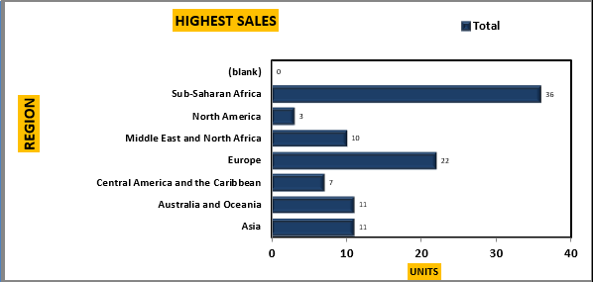
HIGHEST SALES
The analysis reveals that sales are highest in distinct regions, with each area exhibiting varying levels of consumer demand.
By pinpointing these top-performing regions, businesses can tailor their marketing efforts and distribution strategies to capitalize on these lucrative markets.
Sub – Sahara Africa is ranked first with most sales compared to other area.

Slide 6
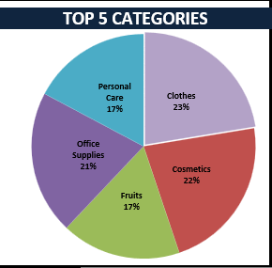
TOP 5 CATEGORIES SALES
The data highlights the top five categories driving sales, showcasing diverse consumer preferences across product segments.
Understanding these leading categories empowers businesses to focus resources on high-demand areas and optimize their product offerings for maximum profitability.

Slide 7

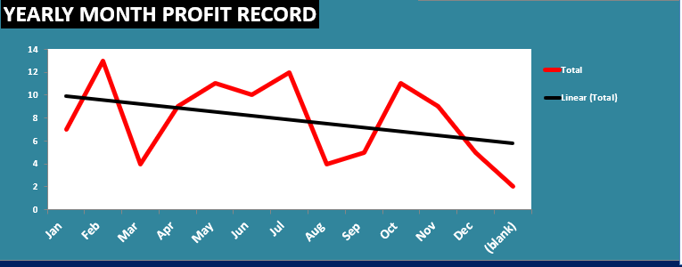
PROFIT PORTFOLIO
What our profits say to us!
Our Profits have been in a continuos sideway trend decreasing in the past years.
Analysis of this tells us that the customers are not purchasing frequently.

Slide 8
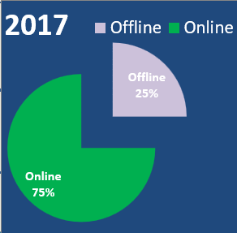
SALES MODE
Last Year was really incredible.
There were 75% of Sales majorly in online,
Which provides necessary appreciations to the social media marketing team who put out advertisements.
Purchasing Offline has minimized thus to bring manpower to Showroom, we must adapt eco – friendly and customer centric approach
Increasing Sale and Offering Discount is Mandatory

Slide 9
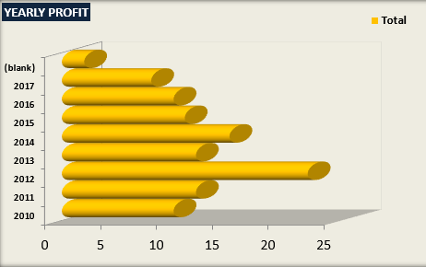
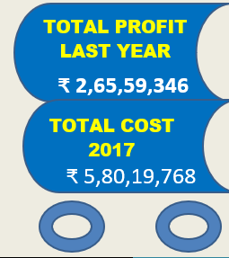
YEARLY PROFITS

Slide 10
ONLINE
Category KING
Women
Customer Prefer Online Products
People Prefer Clothes and Supplies more
Women tend to purchase more products compared to men.
They love Discounts.

Slide 11
Thanks!
divyapaikra3676@gmail.com
https://www.linkedin.com/in/divya-paikra-244840256/
DIVYA PAIKRA

